Slide 1
Opening a New Shopping Mall In Ahmedabad,India
By:Vaishali Chaudhari
March 2021

Slide 2
Business problem
Location of shopping mall is one of most important decision that will determine whether the mall will be a success or a failure
Objective:To analyse and select the best locations in the city of Ahmedadabad, India to open a new shopping mall
Business question:In the city of Ahmedabad, India, if a property developer is looking to open a new shopping mall, where would you recommend that they open it?

Slide 3
Data
Data required
➢List of neighbourhoods in Ahmedabad
➢Latitude and longitude coordinates of the neighbourhoods
➢Venue data, particularly data related to shopping mall
Sources of data
➢Wikipedia page for neighbourhoods(https://en.wikipedia.org/wiki/Category:Neighbourhoods_in_Ahmedabad)
➢Geocoder package for latitude and longitude coordinates
➢Foursquare API for venue data

Slide 4
Methodology
Web scraping Wikipedia page for neighbourhoods list
Get latitude and longitude coordinates using Geocoder
Use Foursquare API to get venue data
Group data by neighbourhood and taking the mean of the frequency of occurrence of each venue category
Filter venue category by Shopping Mall
Perform clustering on the data by using k-means clustering
Visualize the clusters in a map using Folium

Slide 5
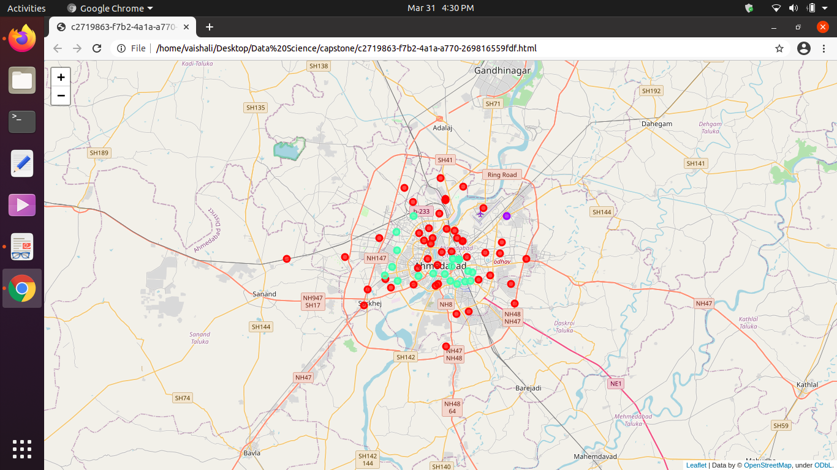
Results
Categorized the neighbourhoods into 3 clusters :
➢Cluster 0: Neighbourhoods with high concentration of shopping malls
➢Cluster 1: Neighbourhoods with low number to no existence of shopping malls
➢Cluster 2: Neighbourhoods with moderate number of shopping malls

Slide 6
Discussion
Most of the shopping malls are concentrated in the central area of the city
Highest number in cluster 0 and moderate number in cluster 2
Cluster 1 has very low number to no shopping mall in the neighbourhoods
Oversupply of shopping malls mostly happened in the central area of the city, with the suburb area still have very few shopping malls

Slide 7
Recommendations
Open new shopping malls in neighbourhoods in cluster 1 with little to no competition
Can also open in neighbourhoods in cluster 2 with moderate competition if have unique selling propositions to stand out from the competition
Avoid neighbourhoods in cluster 2, already high concentration of shopping malls and intense competition

Slide 8
Conclusion
Answer to business question: The neighbourhoods in cluster 1 are the most preferred locations to open a new shopping mall
Findings of this project will help the relevant stakeholders to capitalize on the opportunities on high potential locations while avoiding overcrowded areas in their decisions to open a new shopping mall

Slide 9
Thank You!!

